Slide 1
Title
Authors
Presented at the…

Slide 2

Project on Human Development in Chicago Neighborhoods, 1995-2022
(PHDCN+)
Sampson, Robert J., David S. Kirk and Rebecca Bucci. 2022. "Cohort Profile: Project on Human Development in Chicago Neighborhoods and Its Additions (PHDCN+)." Journal of Developmental and Life-Course Criminology 8: https://doi.org/10.1007/s40865-022-00203-0.

Slide 3
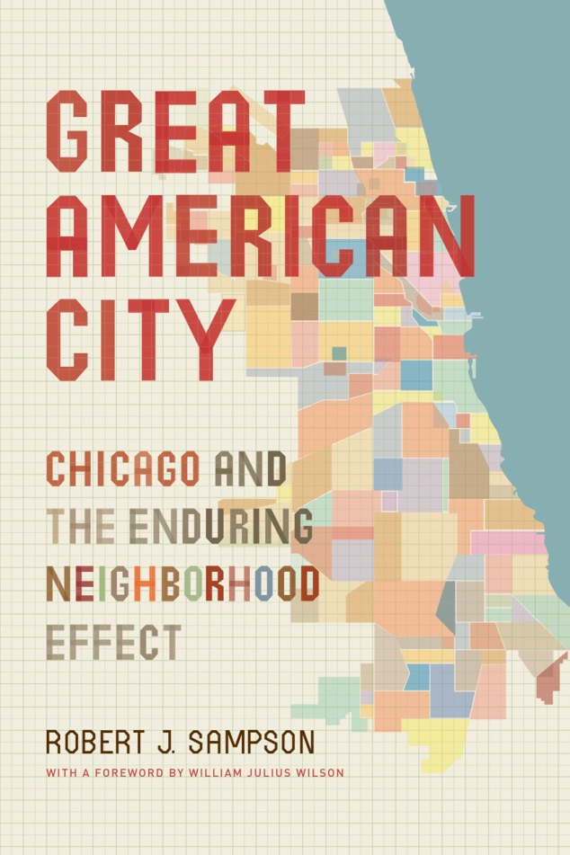
PHDCN Original Design*
Longitudinal study of ~6,200 children
7 age cohorts in 1995 (infant, 3, 6, 9, 12, 15, 18)
Diverse probability samples from 80 neighborhoods
Stratified by race and social class
Three waves, 1995-2002
Parents/caretaker and child assessments
75-78% response rates
Longitudinal study of 343 neighborhoods
Surveys, observations, networks
* Major funders: John D. and Catherine T. MacArthur Foundation and National Institute of Justice

Slide 4
PHDCN — “Wave 4”: N = 1,057, Followed Nationwide
2011-2013 field effort (funded by MacArthur Foundation)
Random sample of original infant, 9, 12, and 15 year-old cohorts that were followed to wave 3
63% response rate overall at wave 4
Analysis weights constructed to reflect attrition bias
Diverse sample: 40% Latino, 37% Black, and 19% White

Slide 5


PHDCN +
Two New 3-year
Awards, 2021-2024
Wave 5: NORC follow-up interviews in 2021 (nationally)
Coding new neighborhood violence measures over time
Criminal justice histories, 1995-2020 (and planned through 2023)
Overall, a 25-year+ longitudinal study of four of the original cohorts

Slide 6
PHDCN+ - “Wave 5”
Multi-Mode Survey
CATI (23.61%)
CAWI (71.41%)
FTF (4.99%)
Conducted May 2021-October 2021
Focal Domains
Gun victimization and exposure
Gun possession/ownership/carrying
Gun use
Fear, perceptions of safety
Criminal offending
Criminal justice contact

Slide 7
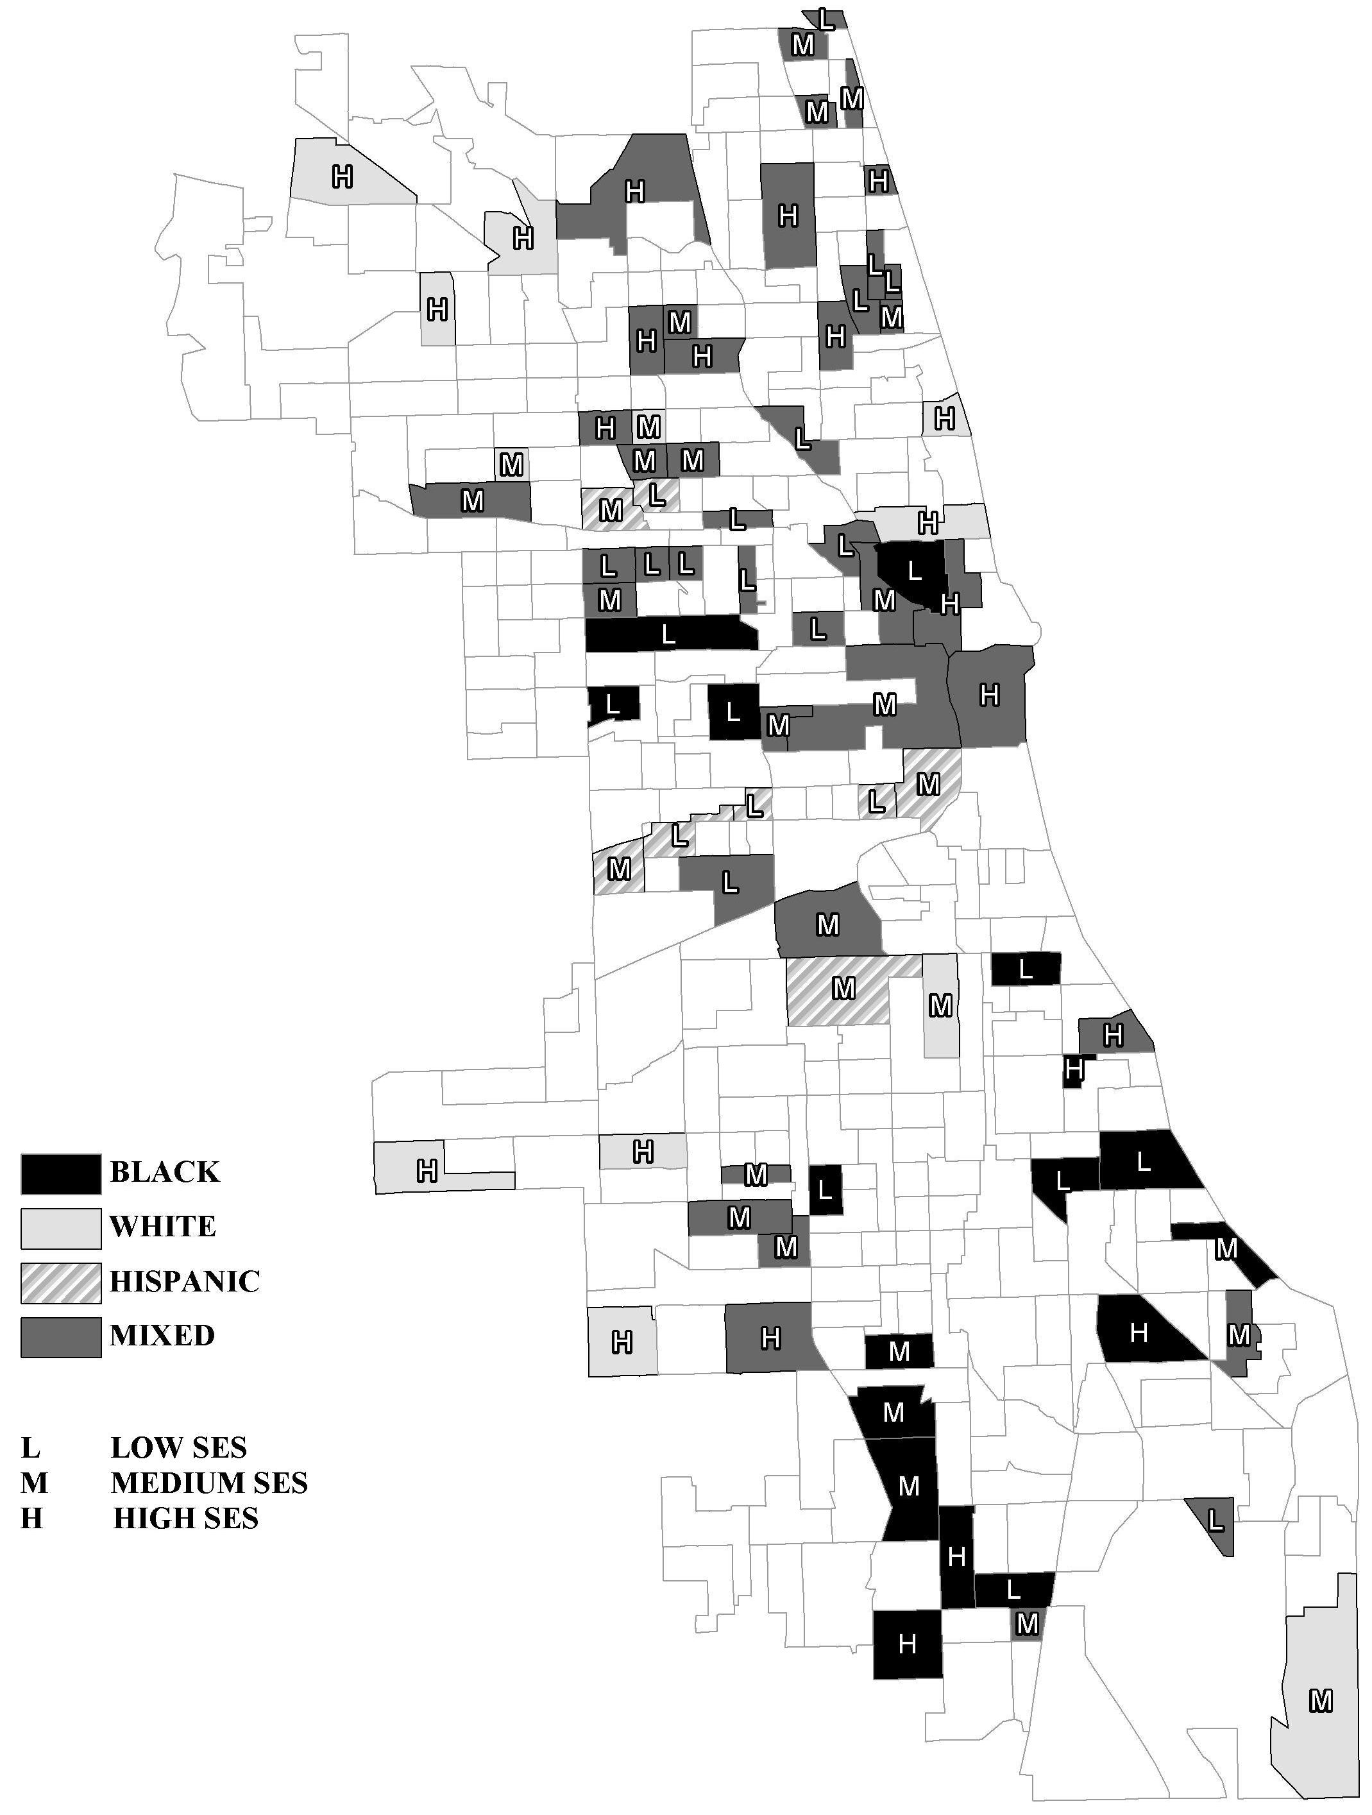
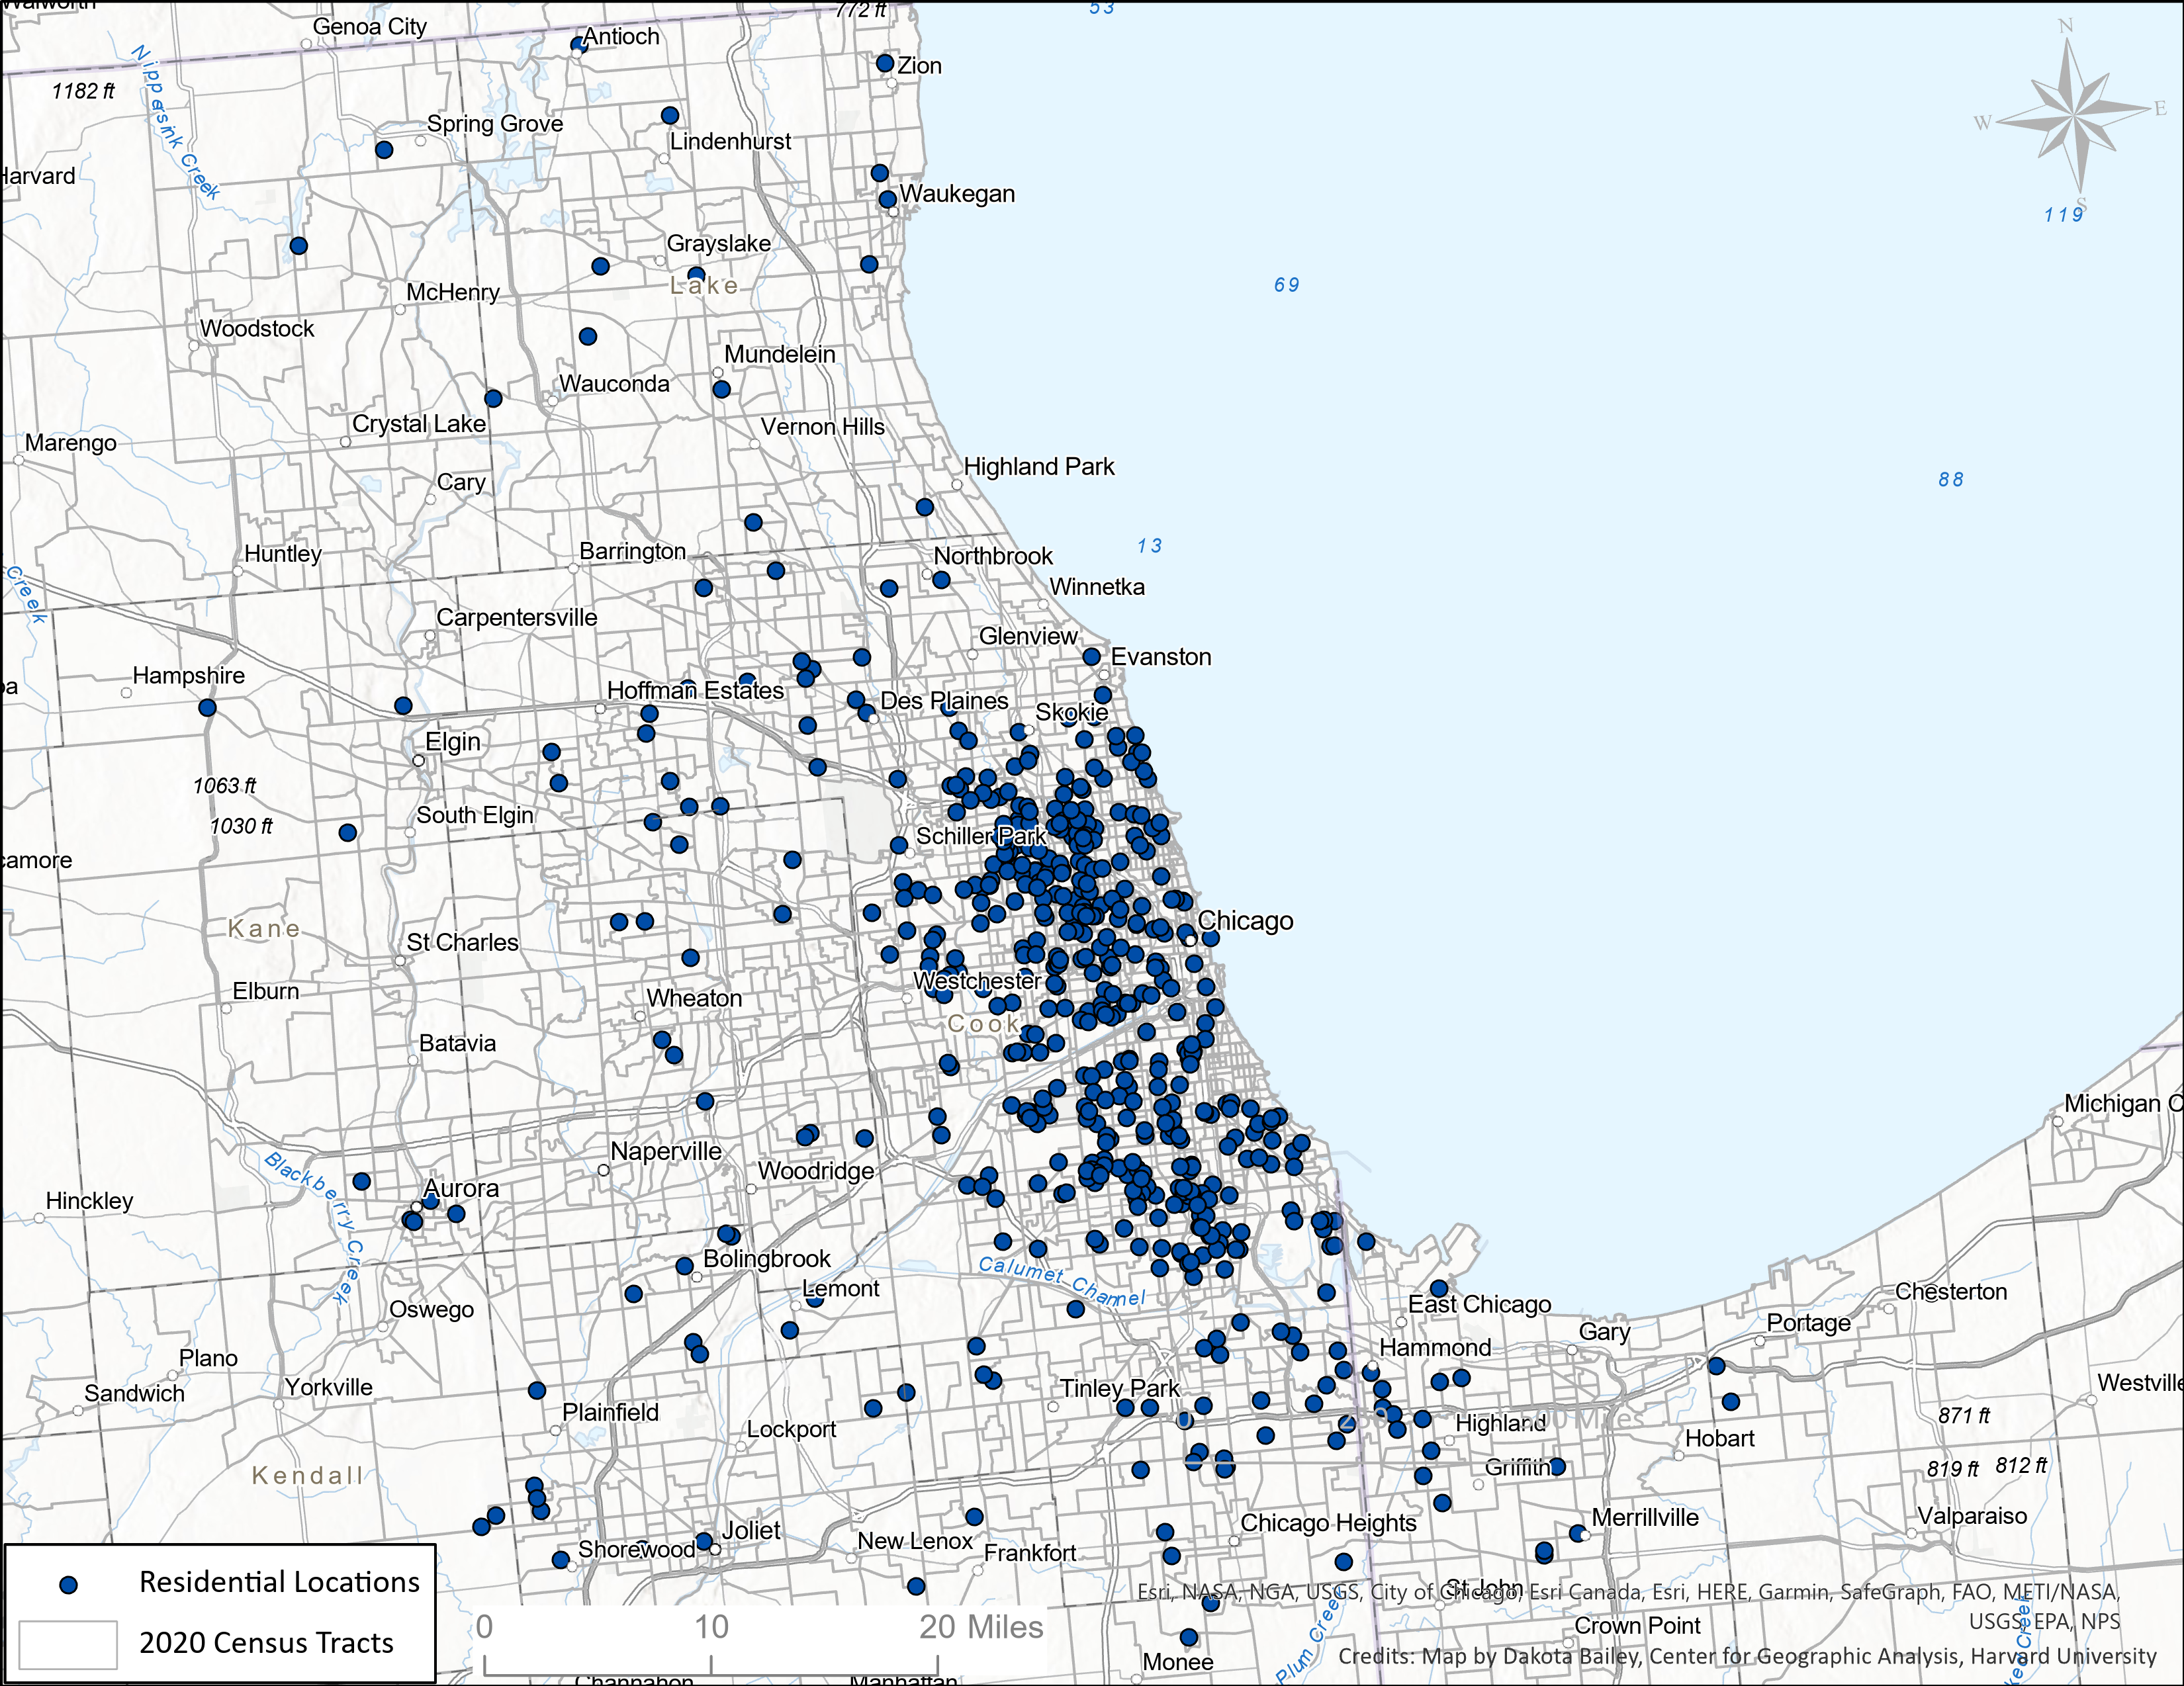
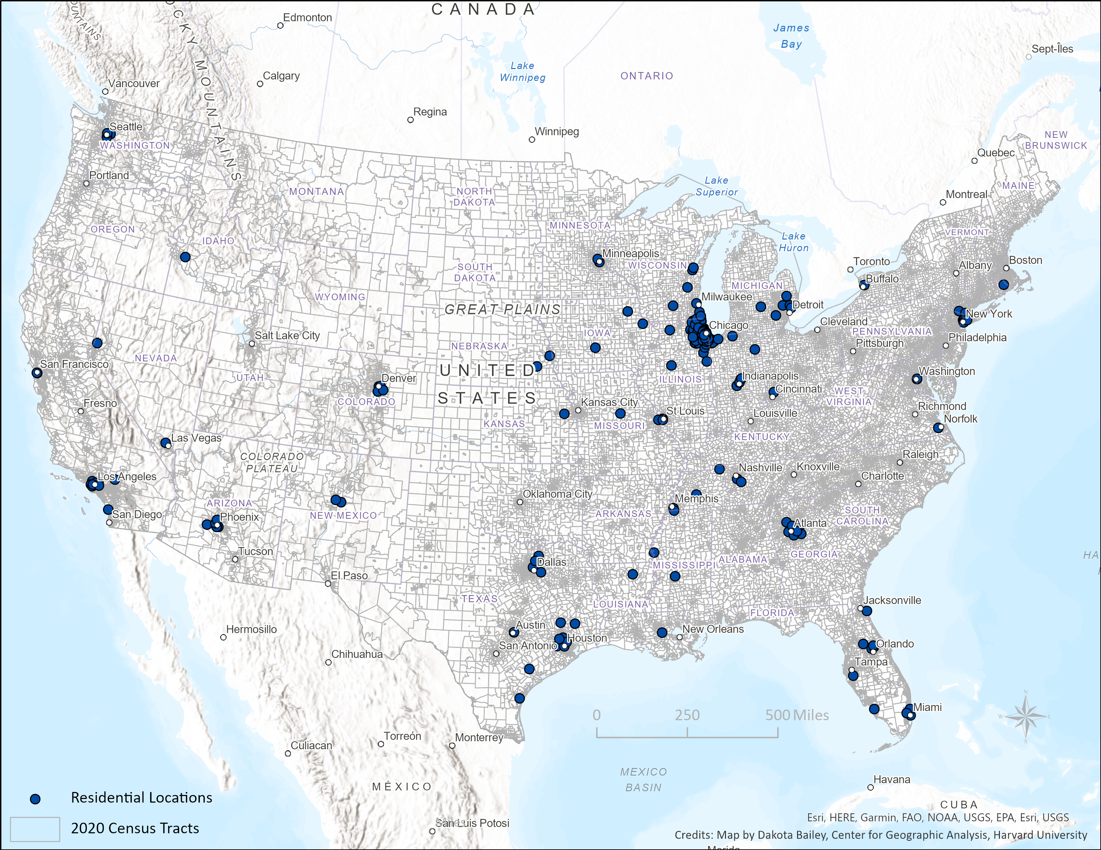
1995
Where are they as of 2021?
NORC Wave 5 Follow-up, N=682

Slide 8
Criminal Justice Histories
Illinois “Criminal History Record Information” (CHRI)
Represents all jurisdictions in Illinois (~1,200) but the vast majority of sample (~88%) stayed in the greater Chicago area
Records by date on all arrests, charges, and sentences, 1995-2020
Probabilistic matching to PHDCN Wave 4 sample; >80% of matches yielded a probability of 100% accuracy, and >90% were ≥99%
Search through 2020 yielded records on ~380 of 1,057 cohort participants (36%), ~1,500 unique arrests, and over 2,300 charges

Slide 9
Benefits of PHDCN+
Representative population sample
Vs. conditioned on CJS contact (e.g., court samples, police encounters)
Rich measurement across multiple domains (child, caretaker)
Linked with official records of criminal history, over 25 years
Intergenerational criminality among children of the prison boom
Contextual, multi-level design
With independent neighborhood-level measures
Long-term follow-up in important historical era
Sequential cohort design, starting at birth, ages 0 to 40

Slide 10

Resulting Sequential Birth-Cohort Design: Children’s Life Course in a Changing Crime,
Criminal Justice, and Inequality Landscape over the Last Quarter Century
“Urban High-Crime Era/ Peak of Start of High Incarceration, Aggressive Pandemic/
Crisis” Rise in Incarceration Violence Crime Decline Policing, Lower Crime Increasing crime
1975 1980 1985 1990 1995 2000 2005 2010 2020 Wave 5
PHDCN+ Study Period
Infant Cohort: 0 5 10 15 25
Early Childhood to Transition to
Childhood Adolescence Adulthood
*******************************************************************************************************
Adolescent Cohorts:
9 year 0 4 9 14 19 24 34
12 year 0 2 7 12 17 22 27 37
15 year 0 5 10 15 20 25 30 40
Early Childhood Transition to Young-Mid
Childhood to Adolescence Adulthood Adulthood

